Slide 1
How to Understand?

Slide 2
We need to be understood
How many sentences used to explain one concept ?
  First: to give the name of concept
  Second: to focus on which field
  Third: to describe more details
  Fourth : to show some easy examples
  Fifth: to follow the related application/properties

Slide 3
An Introduction to Pervasive Computing
Ubiquitous computing
Notes:
pervasive computing Ubiquitous computing
在普适计算的模式下，人们能够在任何时间、任何地点、以任何方式进行信息的获取与处理。

Slide 4
What is pervasive computing？
Pervasive computing is the trend towards increasingly ubiquitous (another name for the movement is ubiquitous computing), connected computing devices in the environment, a trend being brought about by a convergence of advanced electronic and particularly, wireless - technologies and the Internet.
Pervasive computing devices are not personal computers as we tend to think of them, but very tiny - even invisible - devices, either mobile or embedded in almost any type of object imaginable, including cars, tools, appliances, clothing and various consumer goods - all communicating through increasingly interconnected networks.
The goal of researchers is to create a system that is pervasively and unobtrusively embedded in the environment, completely connected, intuitive, effortlessly portable, and constantly available.
Notes:
Unobtrusively悄悄的

Slide 5
Understanding Pervasive Computing & its Reach
What is Pervasive Computing?
– A branch of computing that allows computing elements to
pervade user’s environment to help user(s) preferably without being intrusive
– Involves elements of computing, sensing, communication networking, services
– Demonstrates its ubiquitous nature by being freely available <at times, almost invisible / transparent to the user(s)
– Has hardware, firmware, software (OS, VM, Apps., services)

Slide 6
Pervasive Computing: A definition
Pervasive Computing is a computing technology that pervades the users’ environment by making use of seamless connectivity of multiple independent information devices embedded in the environment of the users.
It does so by:
•Making use of multiple independent information devices (fixed or mobile, homogeneous or heterogeneous)
• Interconnecting these devices seamlessly through wireless or wired
computer communication networks
• Providing a class of computing / sensory / communication services to a class of users, preferably transparently and can provide personalized services while ensuring a fair degree of privacy / non-intrusiveness.
•It is known by many names including Ubiquitous Computing and Invisible Computing.

Slide 7
Professional words
loose coupling
tight coupling
cyberinfrastructure
coupling
advance-reservation-based
autonomous
portability
commodity
nonexclusive
bare-metal
pervasive computing
Ad hoc network
网络基础设施
耦合
提前预约为基础的
自治
可移植性
商品
非独占
裸机
普适计算

Slide 8
Professional words
决策支持
基础设施
同步
异步
同构的
四色定理
图像失真
逆向工程
经验度量
VRML
BPEL
decision support
Infrastructure
synchronous
asynchronous
isomorphic
four-color theorem
Image distortion
reverse engineering
Empirical measure
Virtual reality modeling language
Business Process Execution Language

Slide 9

The Paradigm Shift
New technology?
Fundamentally speaking, it is NOT a totally new kind of computing.
However, it does represent a paradigm shift in design and deployment of a large class of computing-and-communication elements for a specific set of well-defined objectives.
It benefits from the lowering costs and increasing capabilities / capacities of computing / communication elements as well as their easy availability.
It is just a new perspective to computing that draws from a large
number of innovations in the multiple areas of:
Computing (hardware, software, services included),
Communication (for interconnection of devices),
miniature power-systems (for provisioning miniature mobile device power),
Instrumentation (sensory technology included),
material science (for building various physical elements)etc.

Slide 10
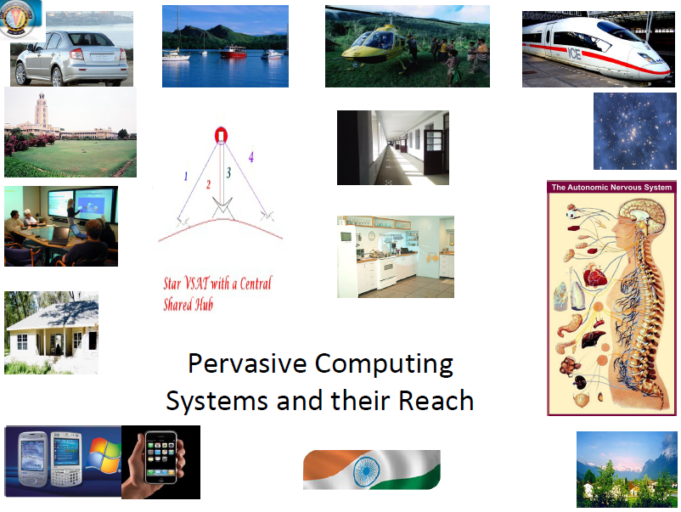

Slide 11
Some Possible Applications
Pervasive Computing involving Hybrid (Regular and Sensor Network-based) Internetworks for:
Natural disaster-specific warning purposes like:
Tsunami Warning,
Forest Fire Warning,
Volcanic Eruption Warning,
Flood-warning etc.
Large-scale monitoring and tracking purposes like:
Wildlife monitoring,
Baggage / cargo monitoring,
Intelligent Transportation Systems
Inter-planetary Networks
Intelligent Transportation Systems
Wearable and Vehicular Computing Systems

Slide 12
Some Application
Oxygen project of MIT
Future computing are as ubiquitous and free as oxygen. The project connects fixed computing devices and mobile devices through an automatically configurable network.
Automatic conversion and environment-driven technology
Sentient Computing of Cambridge University and AT & T Labs
Through the user interface, sensors, and the establishment of resource data, etc., it provides user-based and location-based data update capabilities, the system can be extended to the entire building
Easy Living of Microsoft
Intelligent environment of the system development, involving middleware, geometric world modeling, positioning perception, service description and other technologies.
Notes:
未来计算象氧气一样无处不在并可自由获取。该项目将固定计算设备和移动设备通过可自动配置的网络连接起来。
自动转换和环境驱动技术
通过用户接口、传感器，以及建立资源数据等方式，为系统提供基于用户和位置的数据更新能力，系统可扩展到整个建筑物
智能环境的体系开发，涉及中间件、几何世界建模、定位感知、服务描述等技术。机器视觉、多传感器的自动和半自动校准

Slide 13
Medical system in pervasive computing
Provide access to any kind of medical service at any time, anywhere
An ambulance equipped with a wireless positioning system can accurately locate the scene of the accident, the use of wireless network access to real-time traffic information.
At the scene of the accident, through the portable and mobile devices to monitor the patient's pulse, blood pressure, breathing and other data, through the wireless network access to distributed medical service system, download the medical records and other necessary information.
In addition to the location-based emergency response mechanism, the system also includes remote medical diagnosis based on mobile devices and wireless networks, remote patient monitoring, and remote access to medical databases with patient patient information.
Notes:
提供一种任何时间、任何地点的医疗服务访问
一辆配备有无线定位系统的急救车，可准确定位突发事故现场，利用无线网络获取实时的交通信息。
在事故现场，通过便携式和移动式设备监测病人的脉搏、血压、呼吸等数据，通过无线网络访问分布式的医疗服务系统，下载有关病历数据等必要信息。
除了基于定位系统的应急响应机制，该系统的功能还包括：基于移动设备和无线网络的远程医疗诊断、远程病人监护，以及远程访问具有患者病历信息的医疗数据库。

Slide 14
How Do We Design Pervasive Computing Systems?
• Step-1: Need analysis
• Step-2: Evolving requirement specification and running it through some appropriate sessions of brainstorming
• Step-3: Carrying out Architectural Design and its validation
• Step-4: Carrying out Structural Design and its validation
• Step-5: Simulation / Prototyping
• Step-6: Field-testing involving likely users
• Step-5: Large-scale Production
• Step-6: Large-scale Deployment

Slide 15
Pervasive Computing Design Principles
Four Principles of Pervasive Computing are:
–Distributedeness / Decentralization
–Diversification / Specialized services
–Connectivity (regular or intermittent)
–Simplicity
Notes:
Intermittent 断断续续的

Slide 16
What the Infrastructure must provide?
Pervasive Computing Infrastructure has to comprise of computing elements, communicating elements, sensors, actuators, and interface devices.
Computation to be available widely and freely (not free of cost).
Intermittent connectivity has to be a supported feature due to physical limitations pertaining to power, cost, bandwidth and network congestion.
The infrastructure has to offer seamless connectivity to the devices / entities / services.
It has to support placement and location of uniquely identifiable “information tags / trackable tags” to all devices / entities in the Pervasive Computing environment.
User’s environment must be able to be aware of the user’s context.
Notes:
personal area network PAN
trackable 可追踪的

Slide 17
Components of Mobile Infrastructure for Pervasive Computing
Mobile computing devices
Fixed computing devices
Multimode RF Mobile communication
Fixed-to-Mobile and Mobile-to-Fixed communication system interfaces
Trust system (security and privacy)
Personalized service framework
Notes:
RF是Radio Frequency的缩写
infrastructure (e.g. 3G Mobile systems include UMTS/W-CDMA <Europe & Asia> based on the harmonized 3G I/F ; NTT DoCoMo’s i-Mode/cHTML <Japan, parts of Europe & USA and GPRS/CDMA/TDMA <USA >; 4G Mobile Systems <under research>)

Slide 18
Hardware Device Technologies
 Low-power technologies (Battery technology etc.)
Display technologies
Memory technologies
 I/O technologies
 Processor technologies
 Interfacing technologies
 Biometric technologies
Notes:
CRT,LED,LCD,

Slide 19
Interfacing technologies
Navigation technologies
Haptic interfacing technologies
On-screen / Touch-panel technologies
Voice interfacing technologies
Video-interfacing technologies
Handwriting-based interfacing technologies
Hybrid interfacing technologies
Notes:
Haptic触觉

Slide 20
Summary of pervasive computing
系统无需用户干预或只需要最少干预，
即系统具有自动和动态的配置机制
Anytime,Anywhere,Invisible—无时不在、无处不在而又不可见
Invisible technology, fit into everyday life and disappear in everyday life.
Computing is no longer limited to the desktop, the user can handheld devices, wearable equipment or other conventional, unconventional computing equipment access to computing power and information resources.。
Pervasive computing has a high degree of perception of environmental information
Human-computer interaction more natural
计算机、手机、汽车、家电等能够通过任意网络上网的设备
Notes:
“看不见的”技术，那些融入日常生活并消失在日常生活中的技术。
计算不再局限于桌面，用户可以通过手持设备、可穿戴设备或其他常规、非常规计算设备无障碍地享用计算能力和信息资源。
普适计算对环境信息具有高度的可感知性
人机交互更自然化

